Slide 1
Project Report ON “MEDICAL INVENTORY SYSTEM”

Slide 2
ABOUT THE PROJECT:
The medical inventory system in Python helps the user to maintain medicinal shop record. Likewise, to add suppliers detail, the user has to enter his/her name, address, and phone number.
In order to buy medicine, the user has to select a medicine, then the patient and book date and time.
The design is so simple that the user won’t find any difficulties while working on it.

Slide 3
LIBRARY AND MODULES WE USED IN OUR PROJECT ARE:
This is a simple medical inventory system in Python. This is a simple GUI based application which is very easy to understand and use. It uses Tkinter module for the GUI. Talking about the application, the user can easily add and delete medicines and users too.

Slide 4
TEAM-MEMBERS AND THEIR CONTRIBUTION:
DIYAM TYAGI
Contribution in coding.
Gave the idea how it will looks like ,all the designs of GUI are contributed by him.
Simranjit Kaur
Contribution in coding.
And report work is done by her.

Slide 5
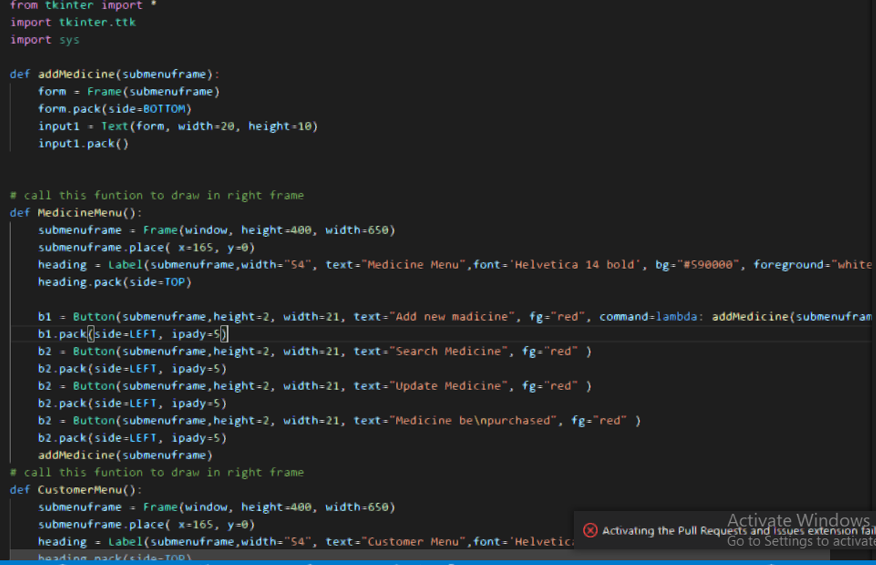
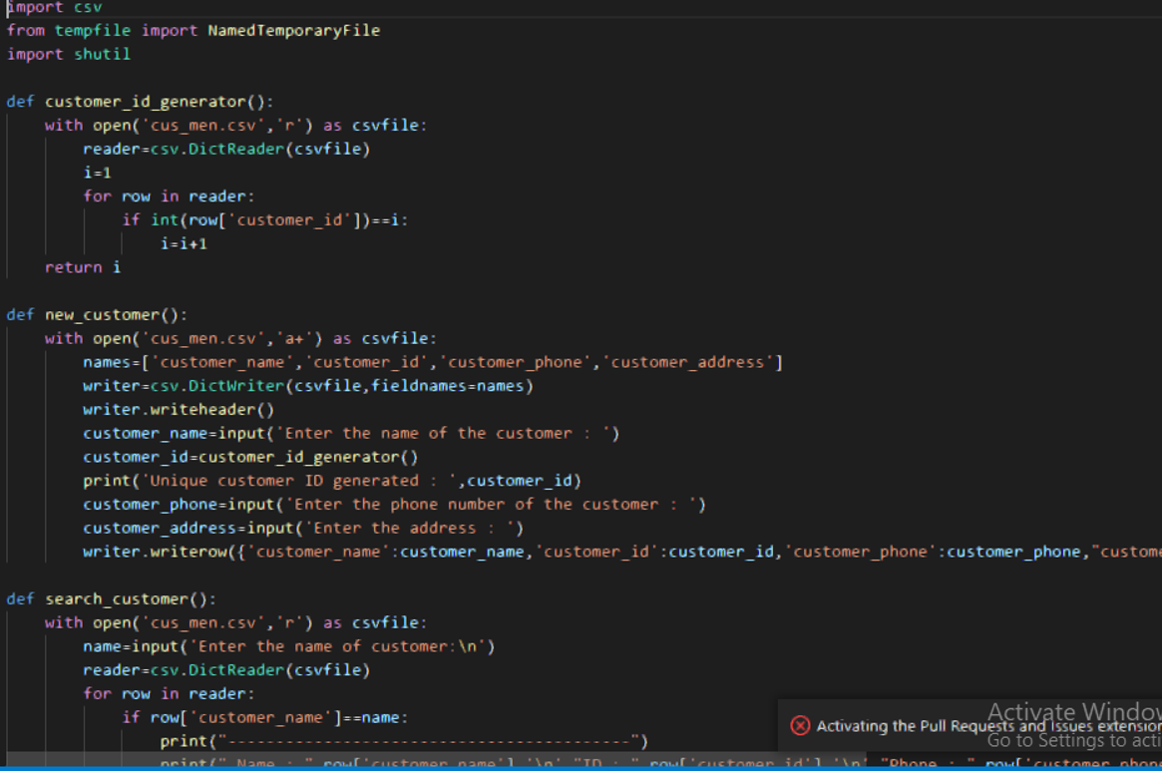
OUR CODE:

Slide 6
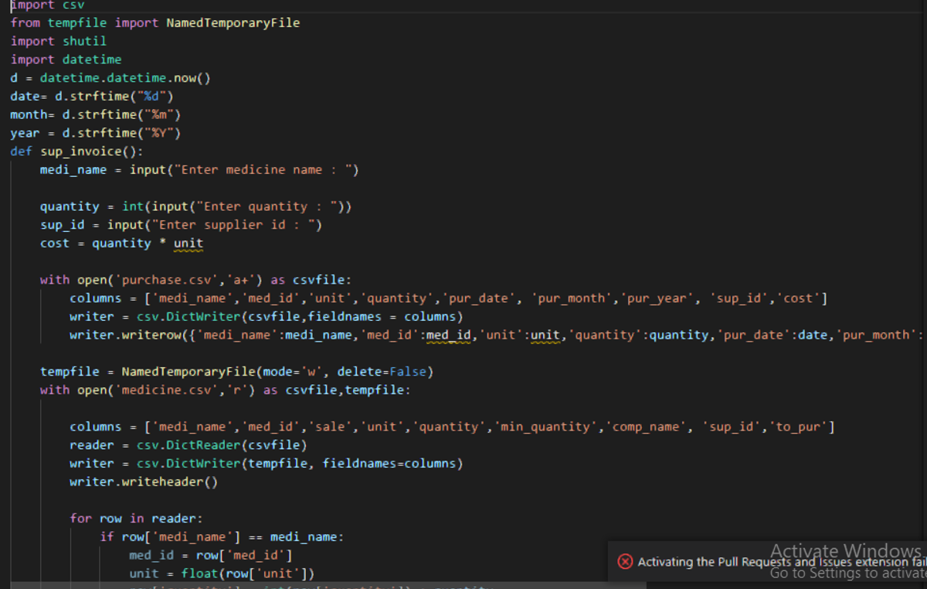
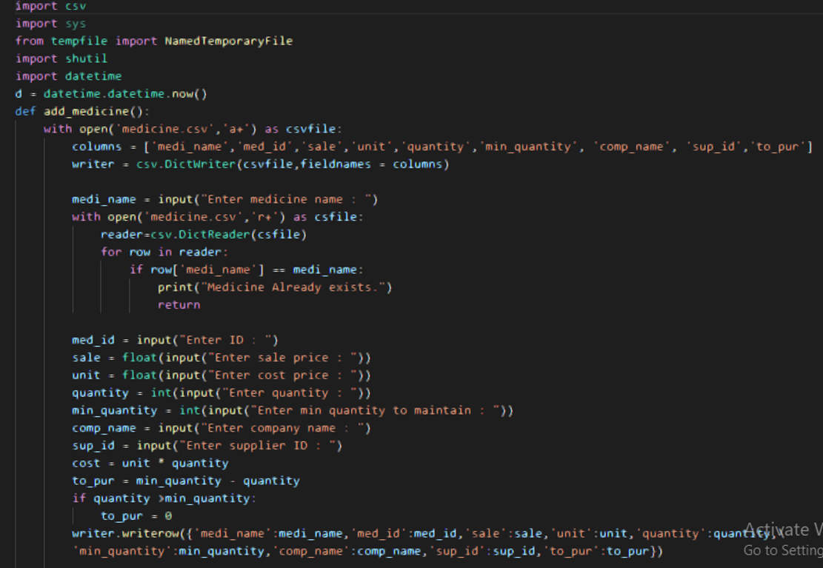

Slide 7
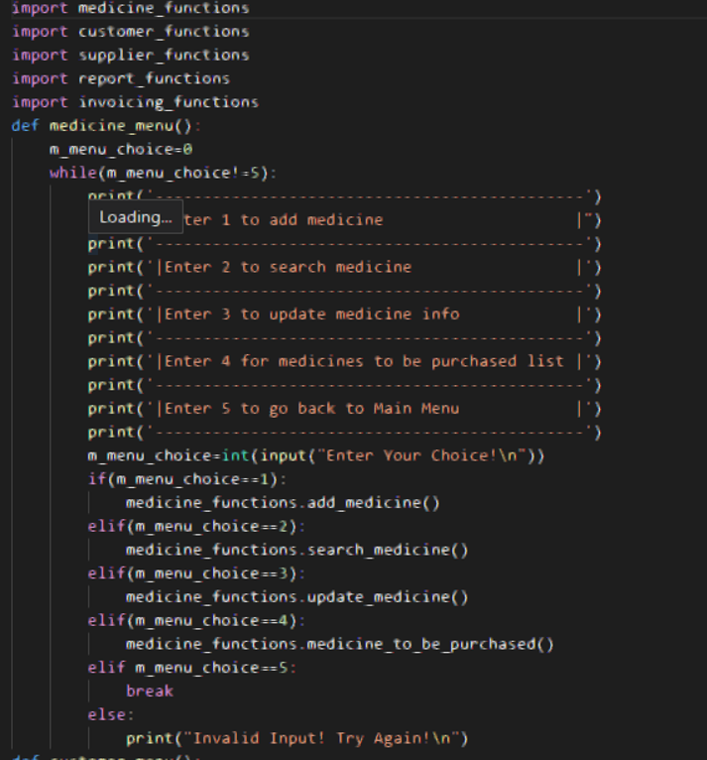
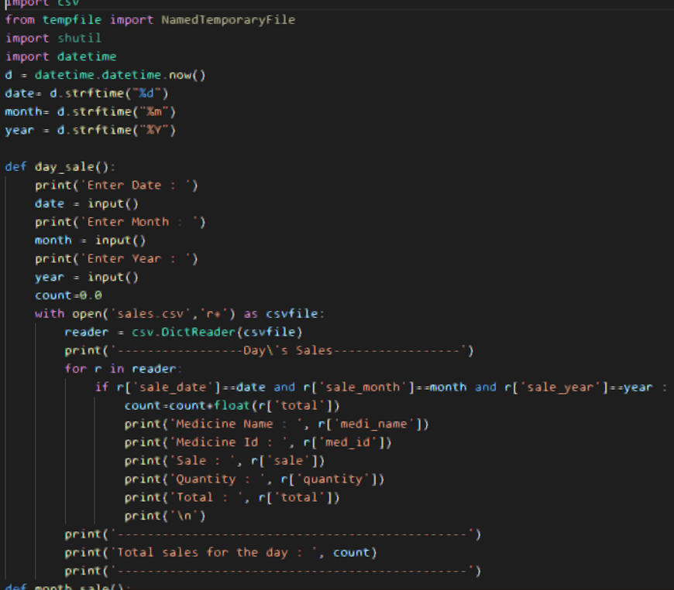

Slide 8
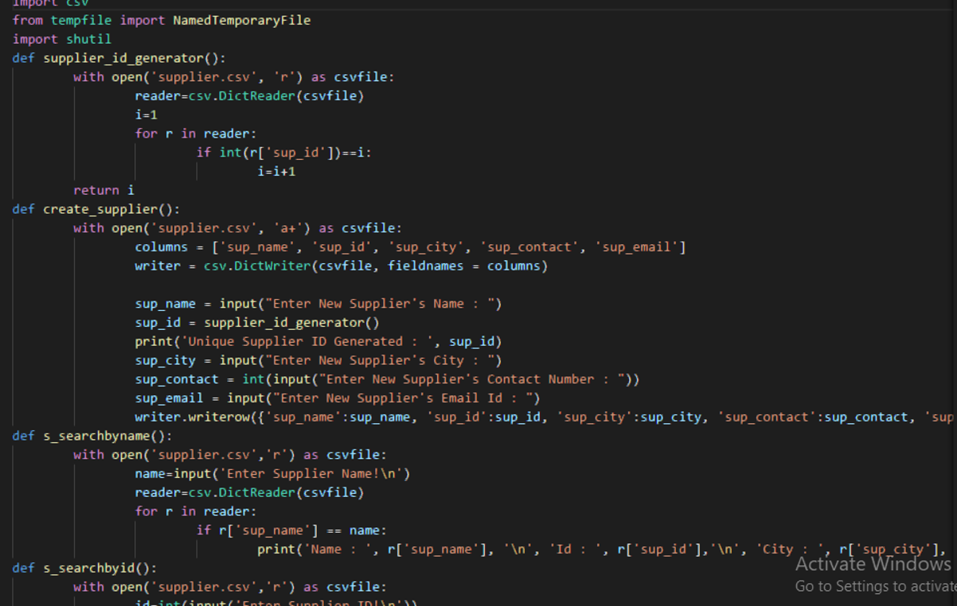

Slide 9
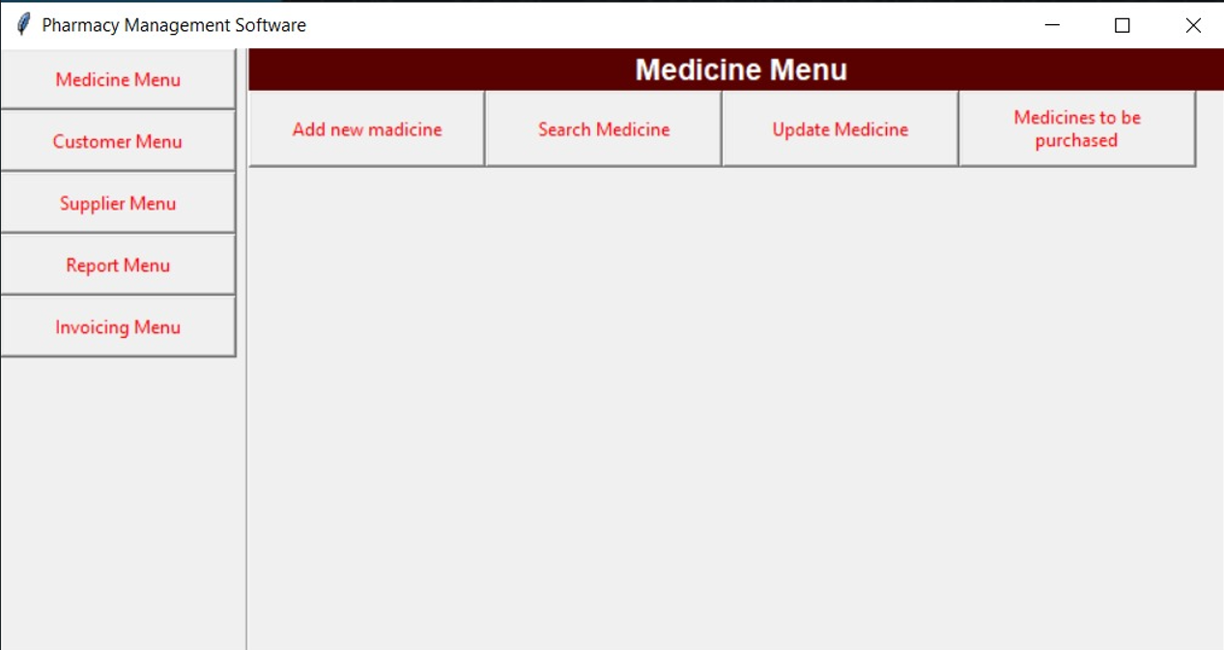
OUR LANDING PAGE:

Slide 10
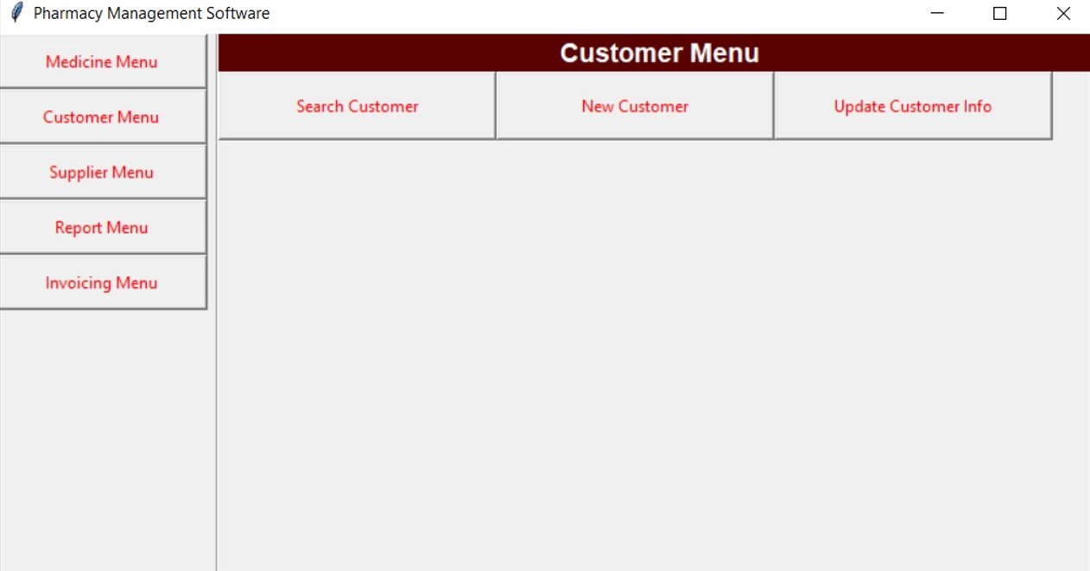
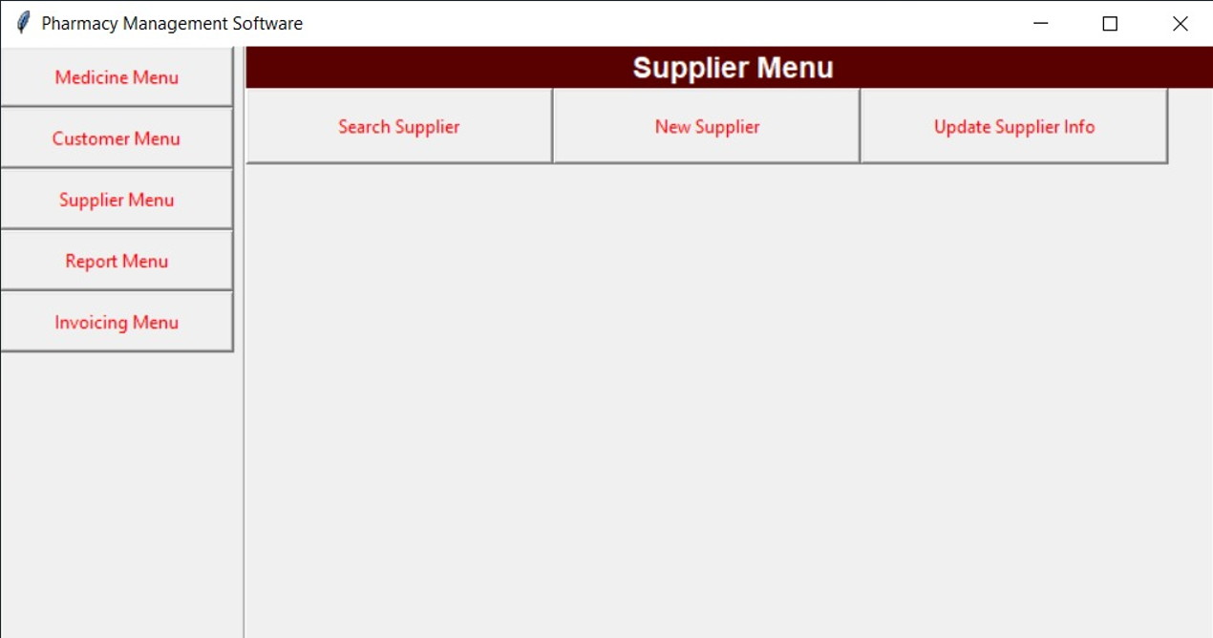
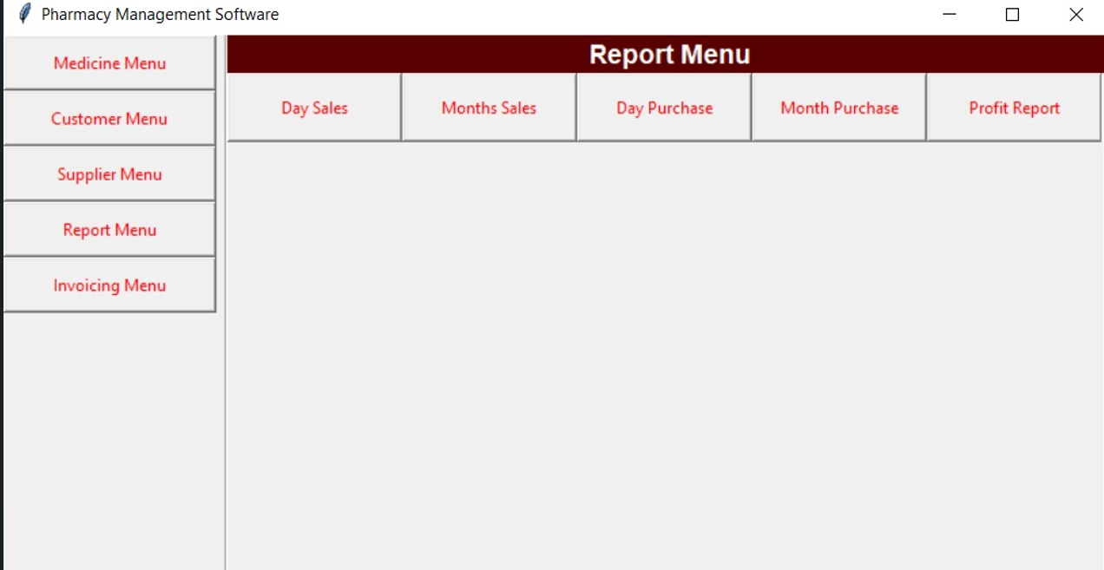
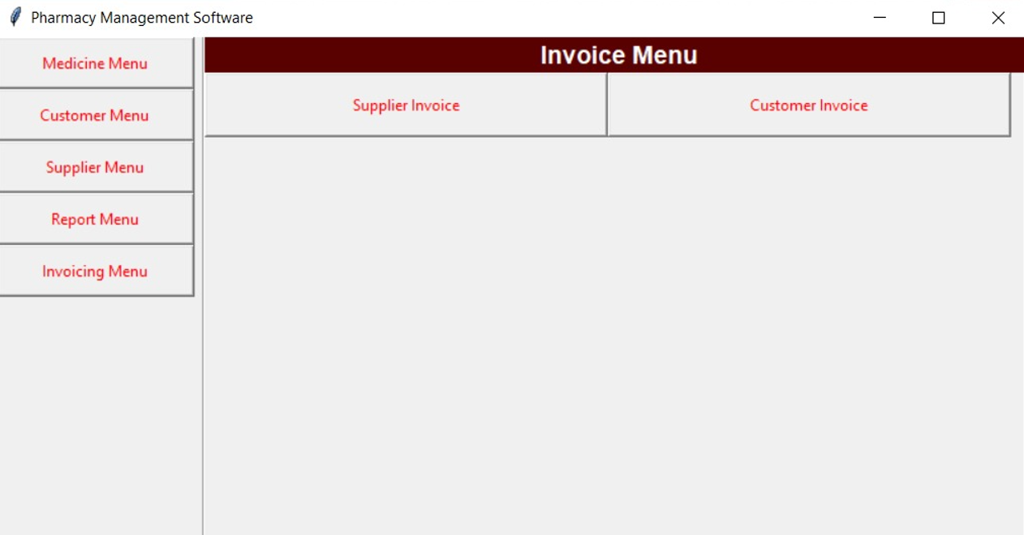
ANOTHER PAGES:

Slide 11
REFERENCES USED IN THIS PROJECT ARE:
YOUTUBE
GEEK FOR GEEKS
W3SCHOOL

Slide 12
CONCLUSION:
This Medical Inventory System Project in is the way to enhance and broaden our competencies and logic ideas which is essential in training the python programming language which is maximum well known and most usable programming language in lots of company. The Medical inventory System Project in Python is a easy GUI primarily based application which is very smooth to recognize and use. It makes use of Tkinter module for the GUI.

